Slide 1

Dual-Verification Security Lock System
Password + Analog Dial Verification using AVR Microcontroller Layered Embedded Architecture

Slide 2
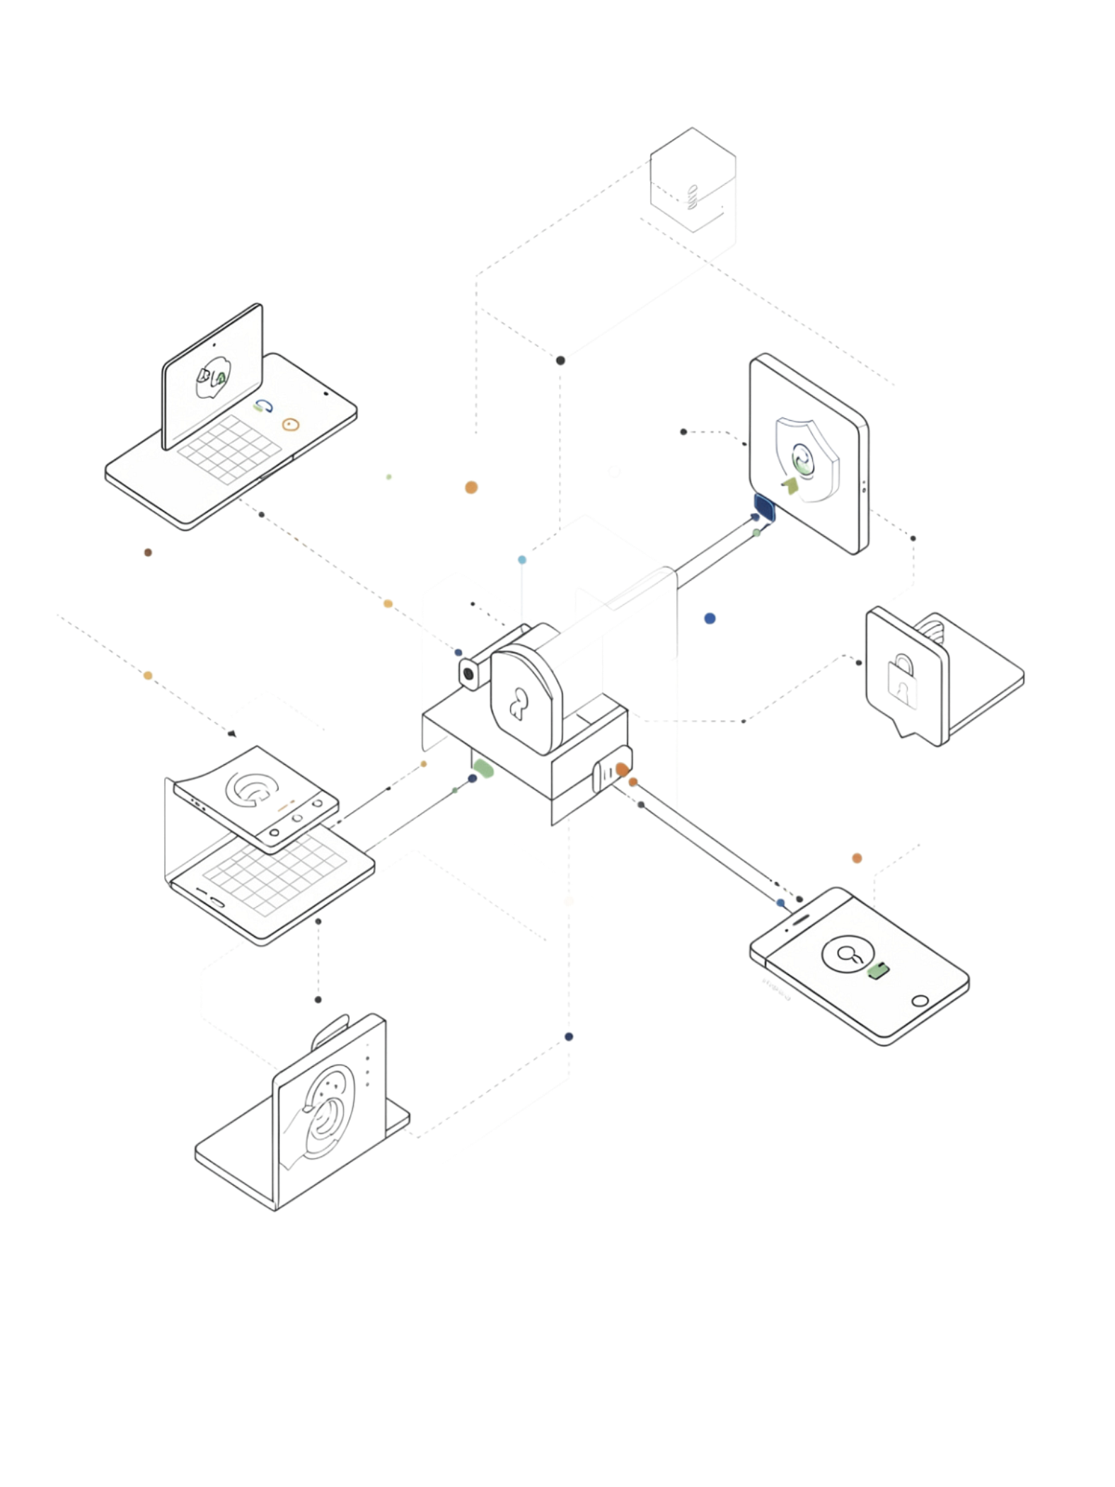
Project Overview
Two-Factor Physical Auth
Dual Condition
Required
Combines digital keypad entry with analog dial verification for robust access control.
Both the correct 4-digit password AND the matching potentiometer position must be verified.
Simultaneous Verification
Access is granted only when both conditions pass at the same moment — neither alone is sufficient.

Slide 3
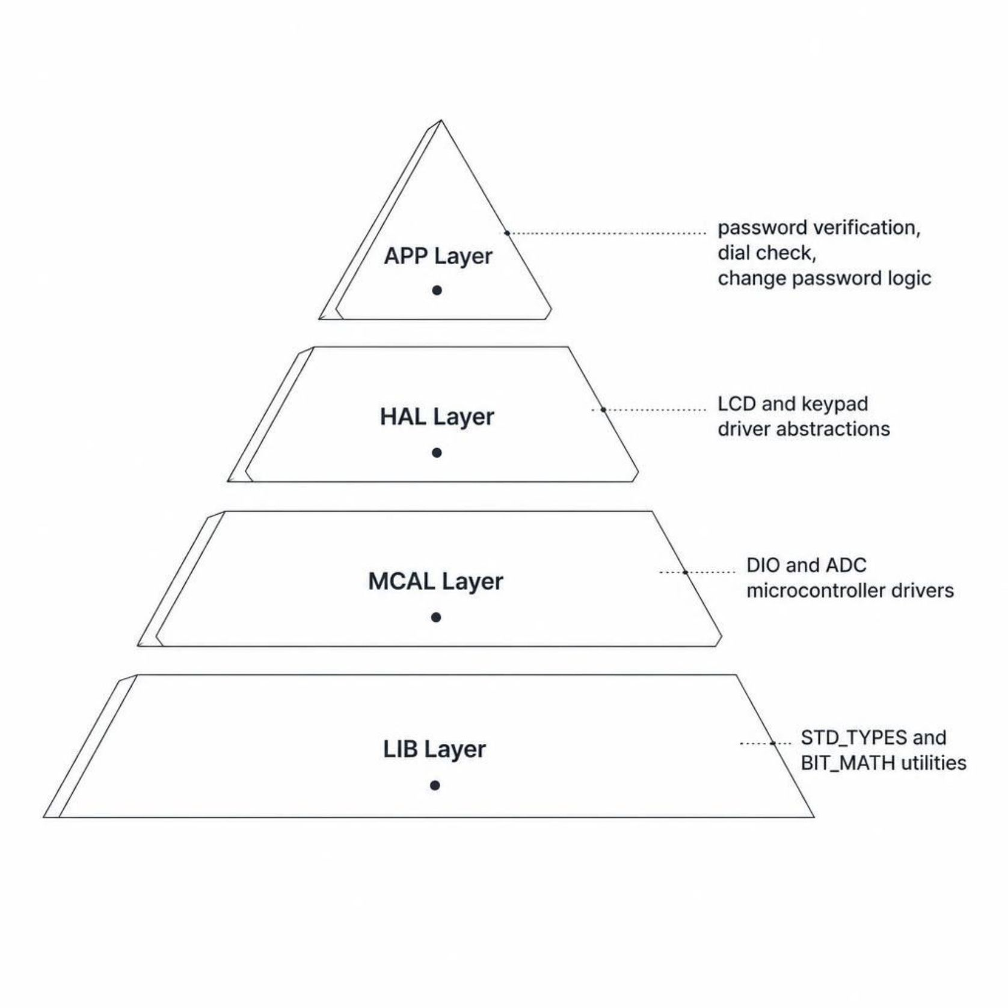
System Architecture: Layered Design
APP Layer
Password verification, dial check, and change password logic — the top-level application logic.
HAL Layer
LCD and keypad driver abstractions decoupling hardware from application code.
MCAL Layer
DIO and ADC microcontroller peripheral drivers operating at register level.
LIB Layer
Foundational utilities: STD_TYPES and BIT_MATH macros shared across all layers.

Slide 4
Hardware Components
4×4 Keypad
16×2 LCD
Potentiometer + ADC
Primary password entry interface using matrix scanning.
Real-time user feedback and system status messages.
Analog dial verification — converts rotation to a 0–99 value.
LED Indicator
AVR Microcontroller
Alert - Buzzer
Visual access status — blue for approved, red for denied.
Central system controller orchestrating all peripheral interactions.
Safety alert when a wrong password is entered 3 time.

Slide 5
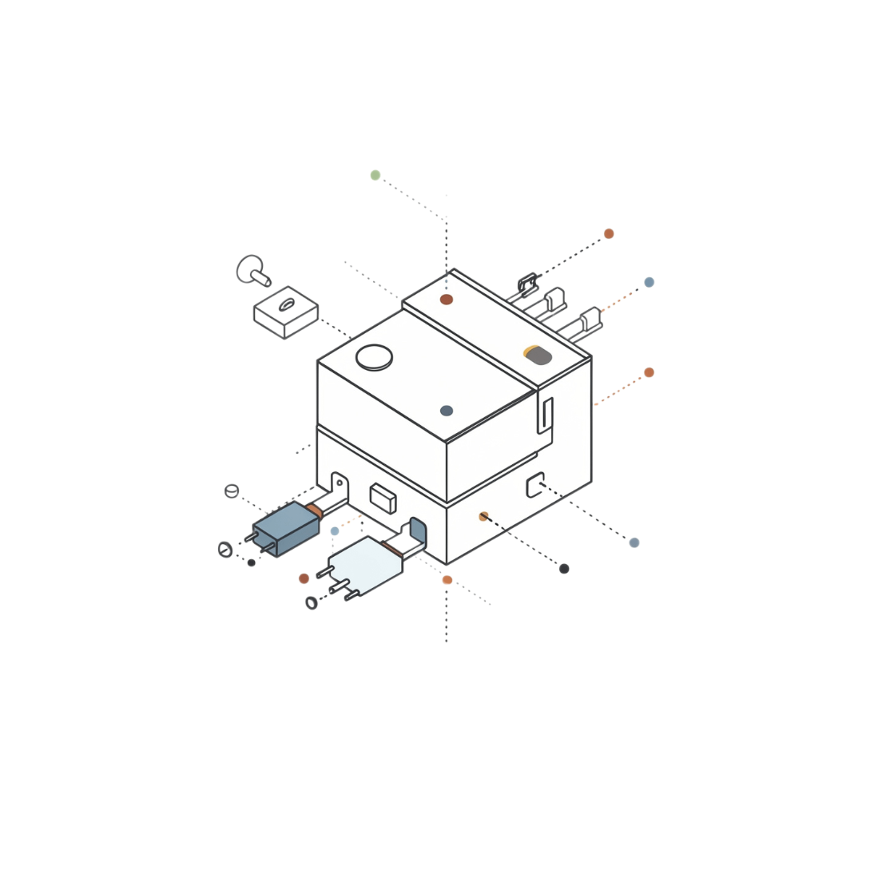
MCAL LAYER
DIO Driver
Digital I/O Module
The DIO driver provides register-level control of all microcontroller GPIO pins, enabling flexible and portable hardware interaction.
Configurable pin direction (input/output) and value control per pin
Direct register access: PORT, DDR, PIN registers
Supports all 4 ports — A, B, C, D — with independent configuration

Slide 6
MCAL LAYER
ADC Driver: Analog-to-Digital Conversion
10-bit
0–99
Resolution
Dial Range
Raw values spanning 0 to 1023
Mapped output for potentiometer position
Configuration
Selectable voltage reference: AVcc, internal, or external
Configurable prescaler for optimal conversion speed vs. accuracy
Potentiometer reading scaled from raw 10-bit value into a Dial Value (0–99)

Slide 7
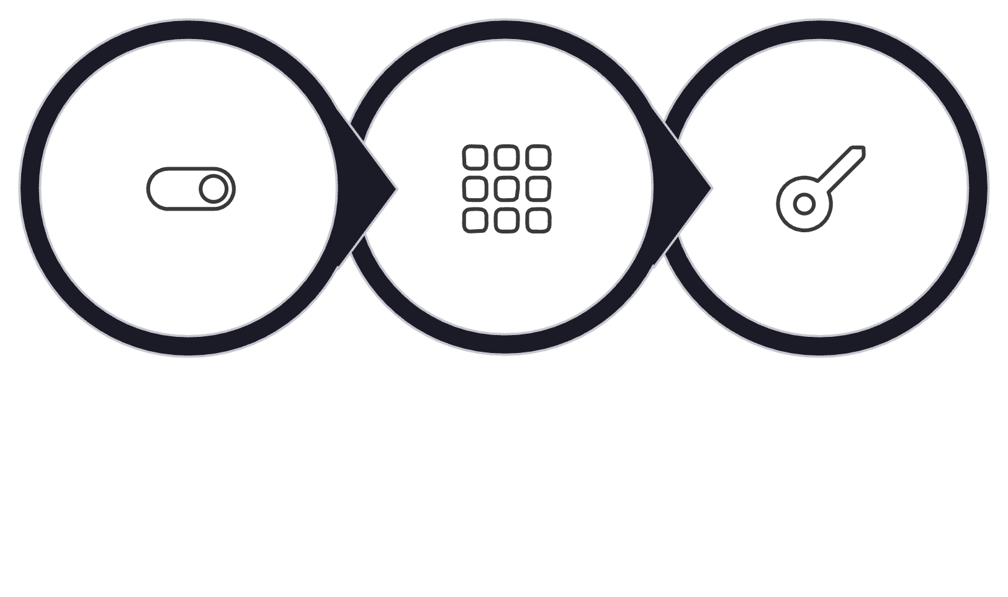
HAL LAYER
Keypad Driver
Matrix Scanning
Row/column scanning technique for full 4×3 matrix coverage
Software debounce: 30 ms delay eliminates contact noise and false triggers
Returns a pressed key identifier or a "not pressed" status flag
Row Drive
Column Read
Key Decode

Slide 8

Security Logic Flow
Welcome
Password Verify
Dial Verify
Access Decision
The system enforces strict sequential verification — password first, then dial position — before granting any access.

Slide 9
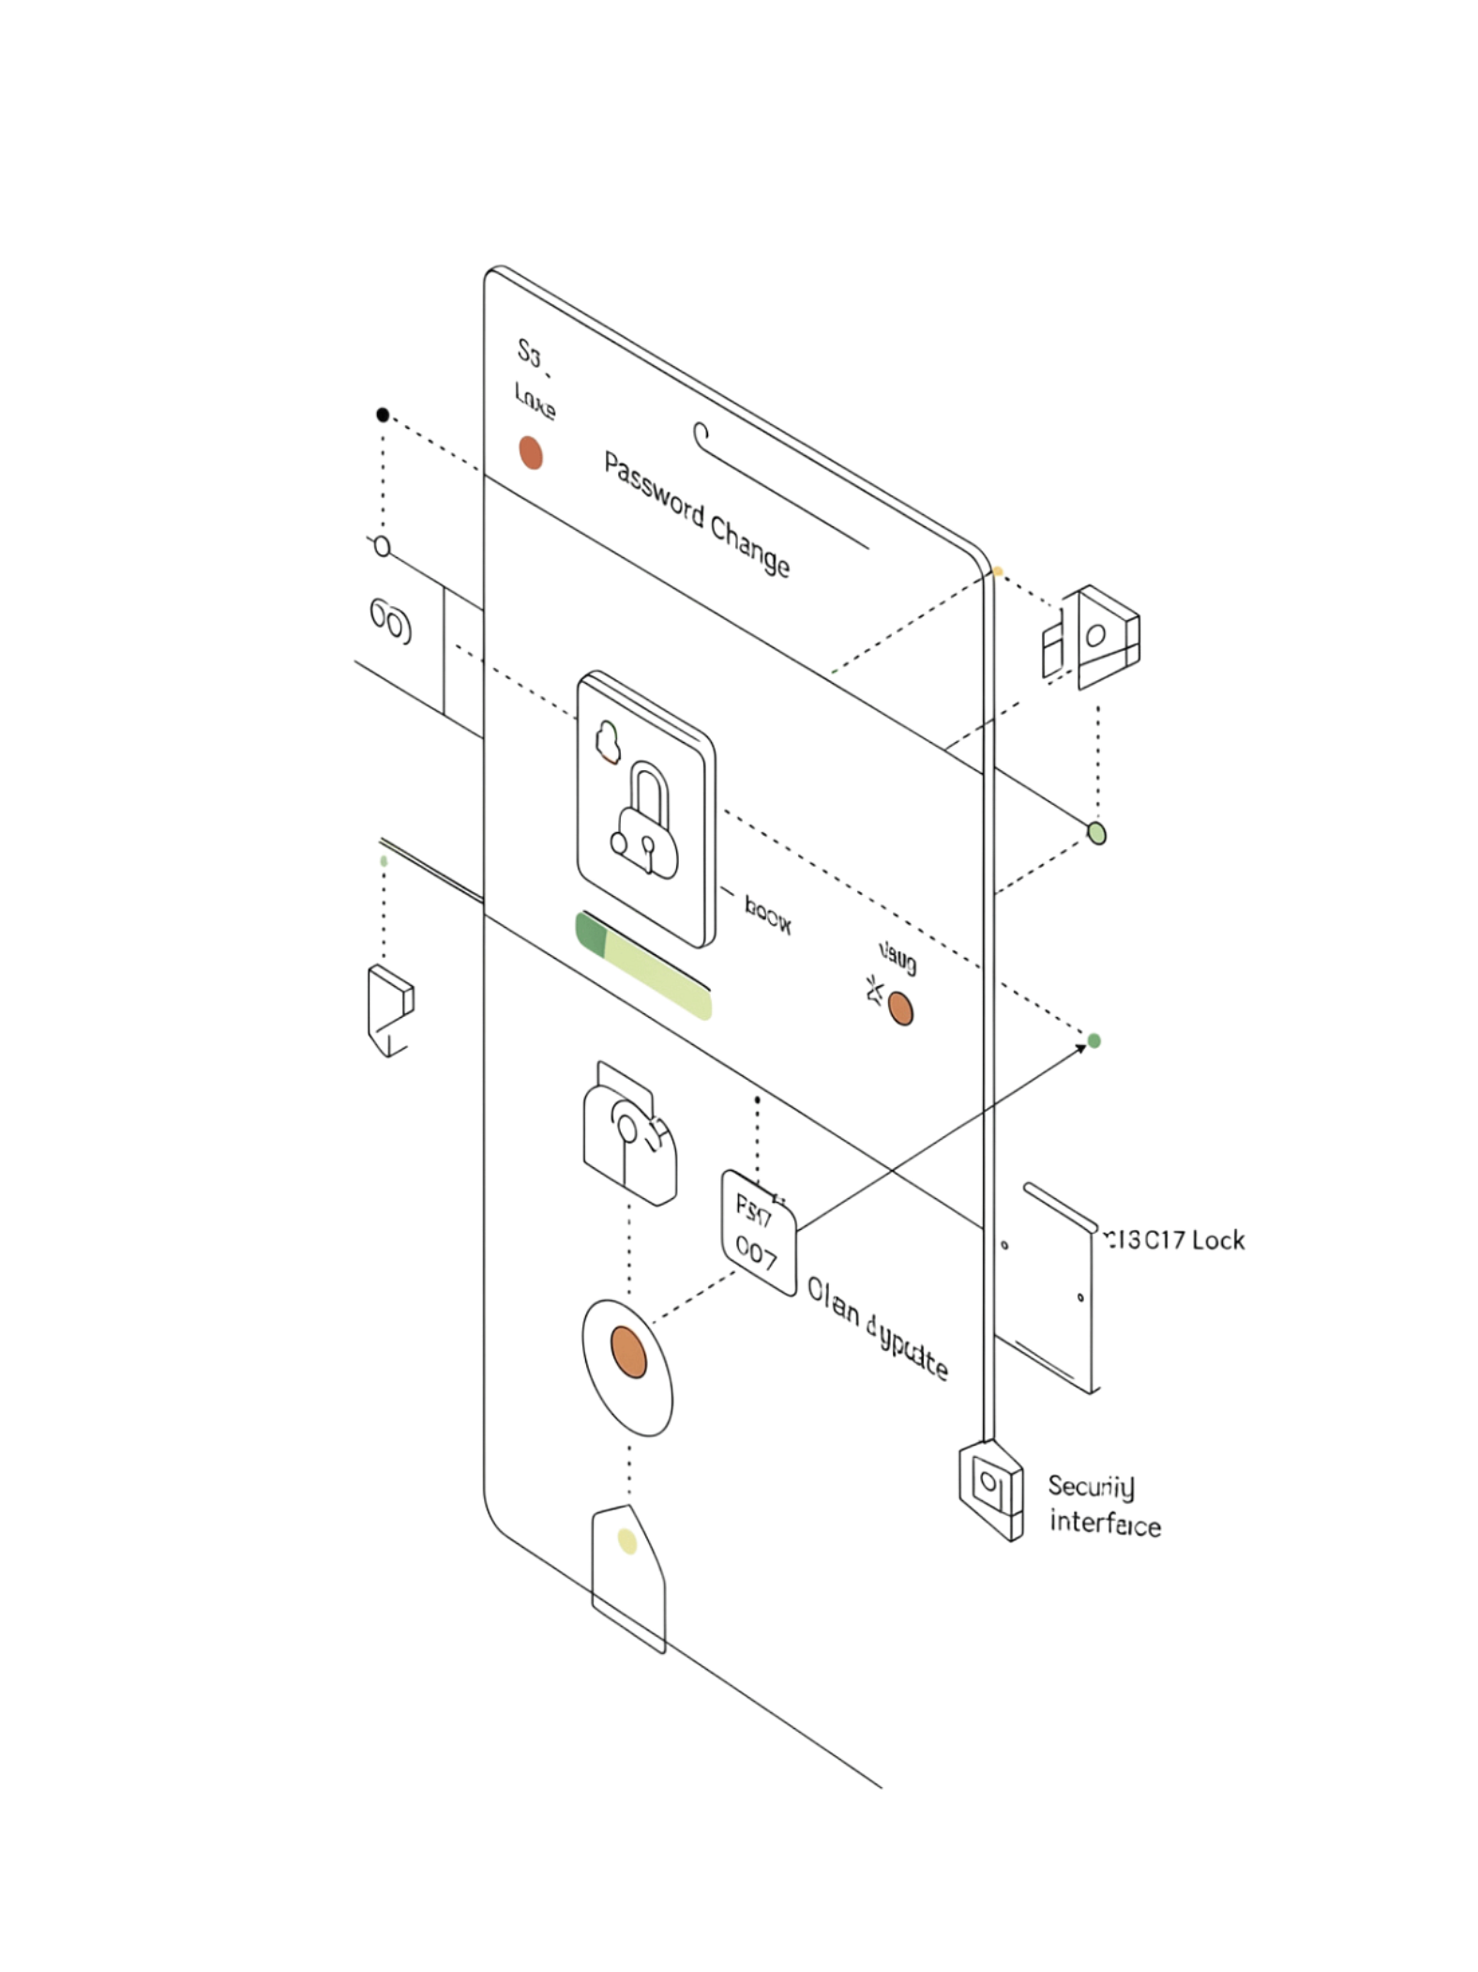
Change Password Feature
1
2
Verify Identity
Dual Confirmation
User must enter the old password and confirm the current dial position before any change is permitted.
Both credentials must pass verification — either failure blocks the change request entirely.
3
Store New Password
Once verified, the system accepts and stores the new password, completing the update securely.

Slide 10
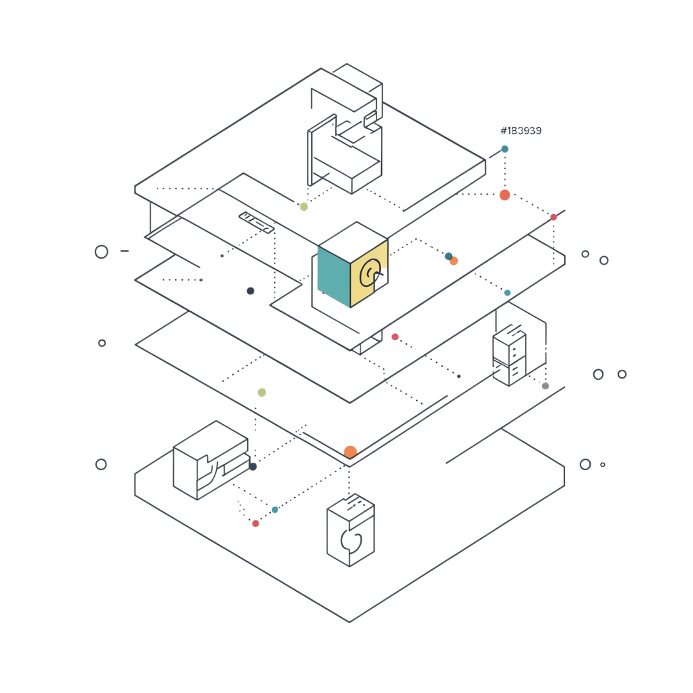
Key Design Principles
Modular Layered Architecture
Reusable Portable Drivers
DIO, ADC, Keypad, and LCD drivers are self-contained and hardware-independent.
Clean separation of concerns across all 4 layers — APP, HAL, MCAL, LIB.
Register-Level Abstraction
Defensive Programming
Input validation enforced at every driver function boundary across all layers.
Hardware details fully encapsulated — upper layers never touch registers directly.

Slide 11
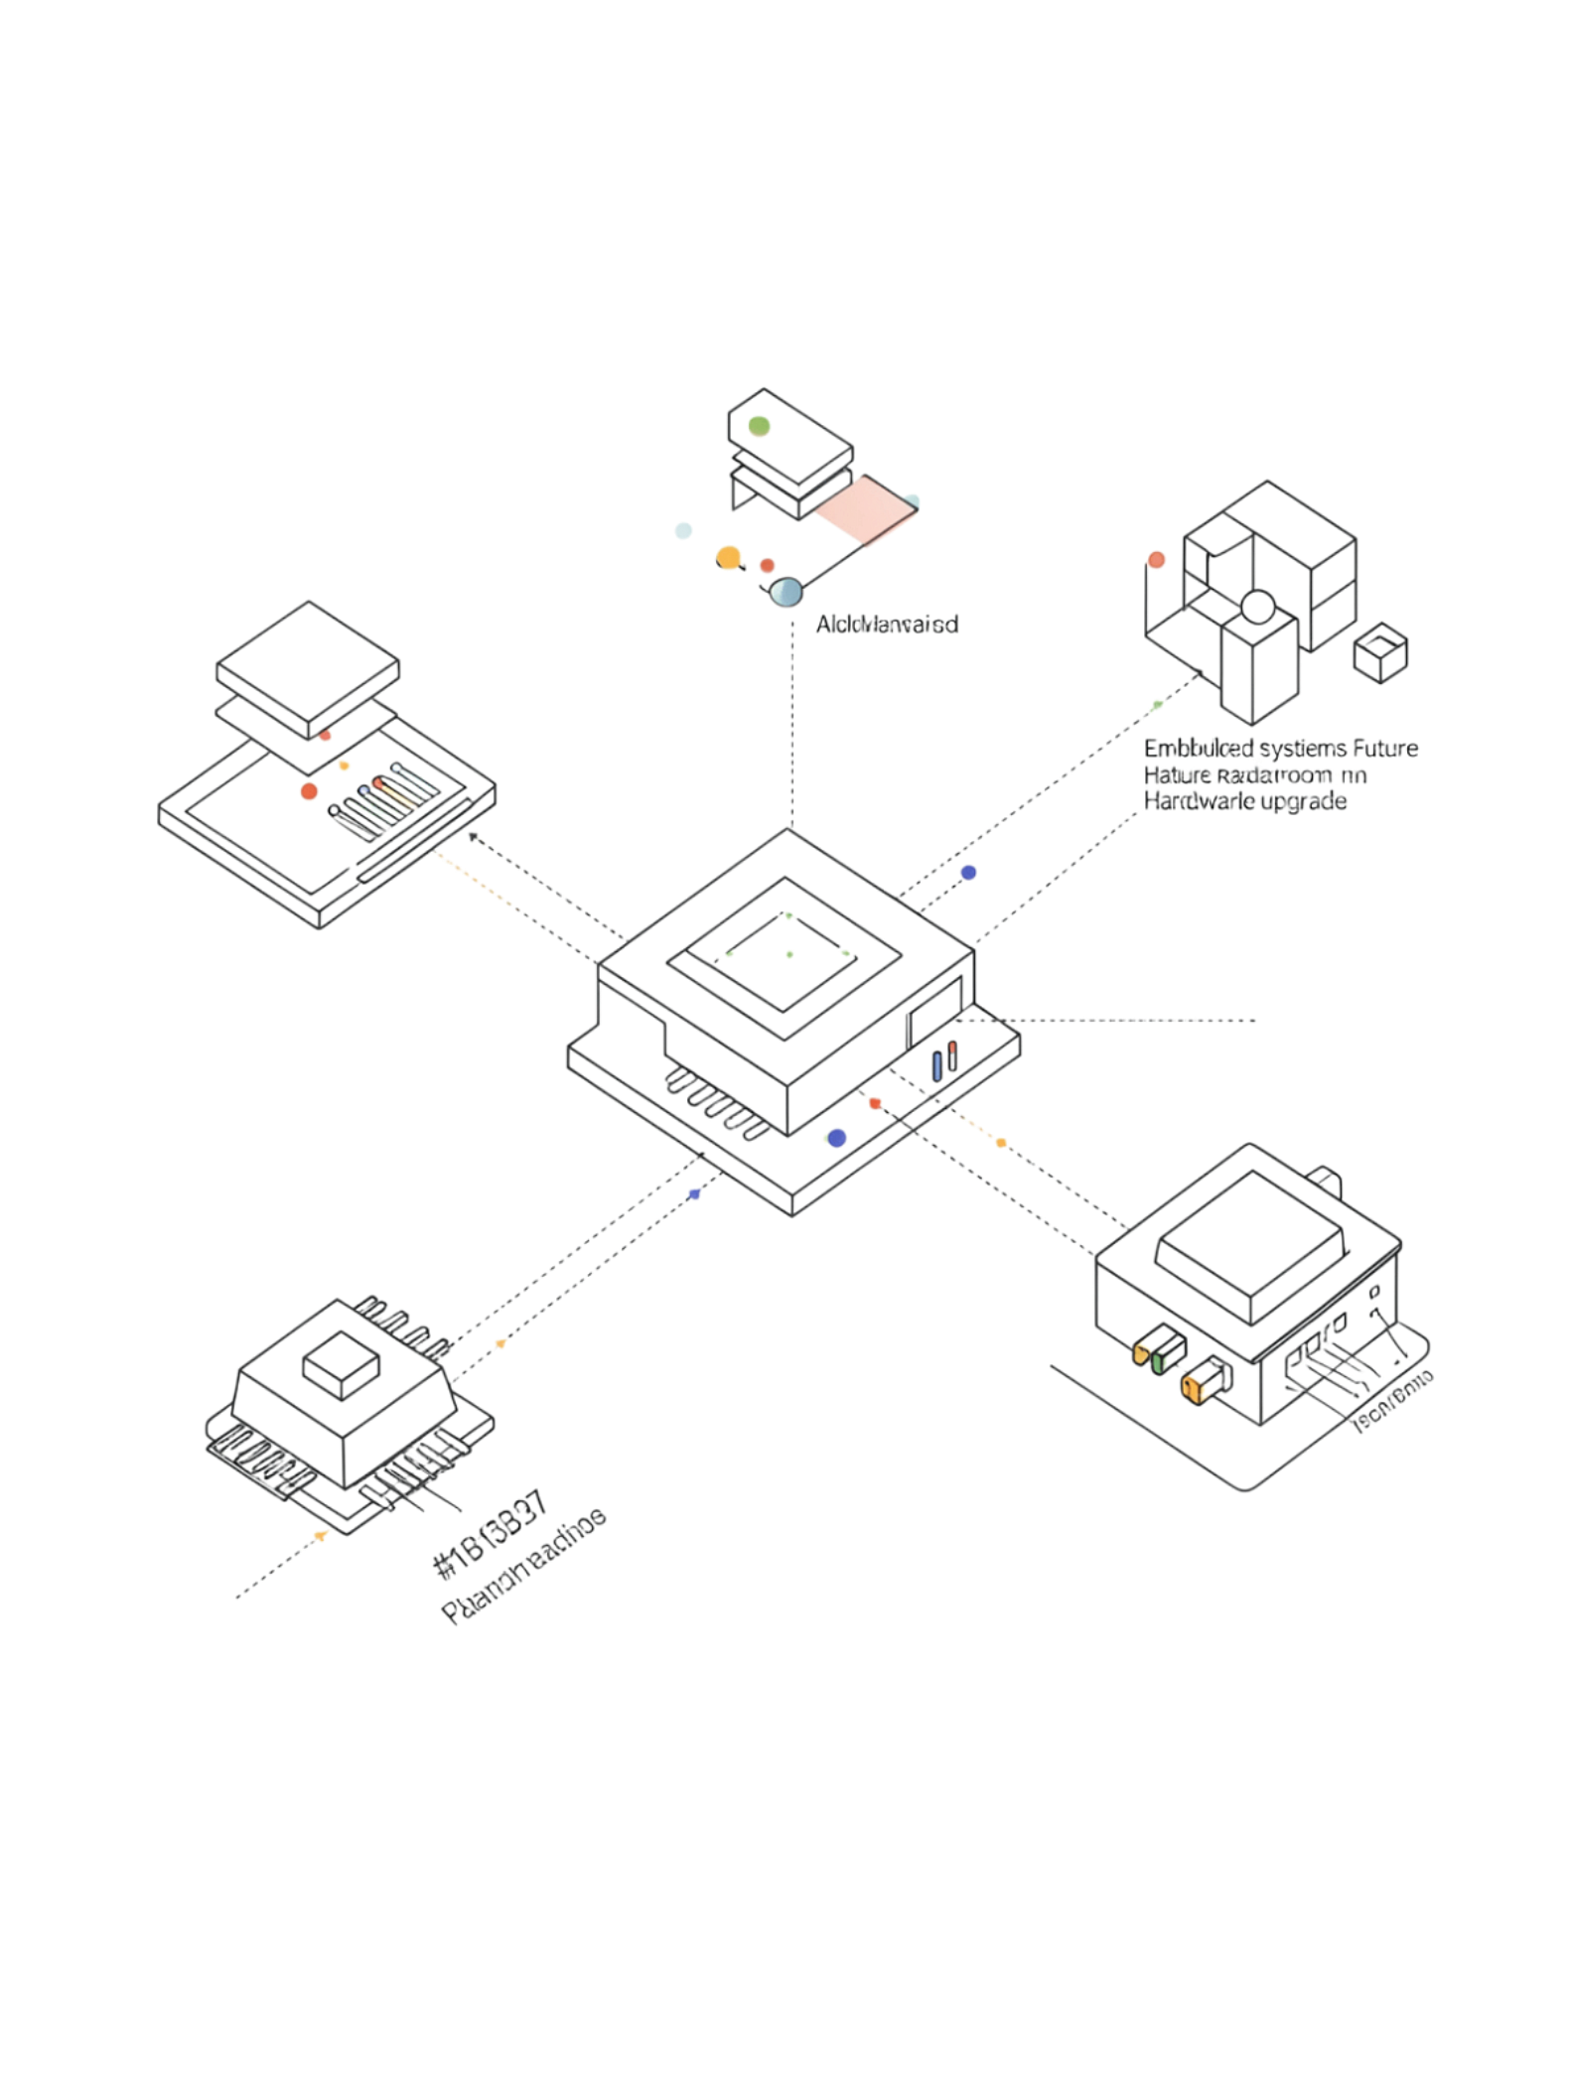
Future Improvements
Attempt Limits & Lockout
Cap failed authentication attempts and lock the system after a configurable threshold.
Buzzer / Alarm
Audible alert triggered on each 3 times failed authentication attempt for physical deterrence.
RTC Lockout Timer
Real-time clock enforced cooldown period to defend against brute-force attacks.

